Slide 2
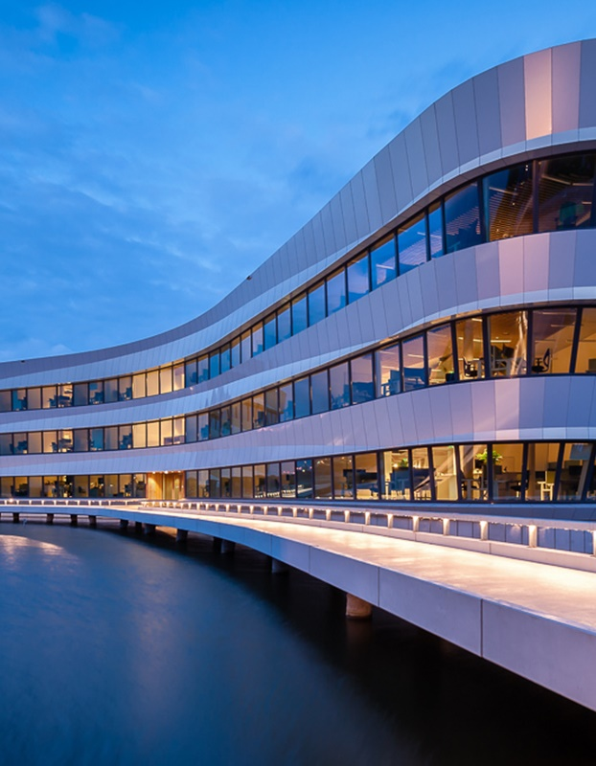
SO Deltaportfolio
Long term delta developments
Gijs Janssen
Ida de Groot-Wallast
Naam Achternaam

Slide 3
Why a deltaportfolio?
A deltaportfolio provides an accessible overview of Deltares work
Underlining the integral approach
Using a generic approach
Visualizing connections between projects
To be seen externally
As nice examples for our work, marketing purposes
As examples for our integral, generic approach
To be used internally
Afstemming SITO-programmes
As a (data)base for proposals
As a means to see gaps in our portfolio
“Deltares” approach

Slide 4
Activities
2021
First thoughts about set-up towards a plan
Purpose, set-up and testing powerBI
2022 Proof of concept (Mekong & Senegal)
2023 Operationalize
GO!
Online
Add new delta’s (projectteams themselves!) :
Colombia
New Orleans?
Improve the concept
Optimise (interactive, accessible) design
Promote the value for Deltares
Learn lessons!
2024

Slide 5
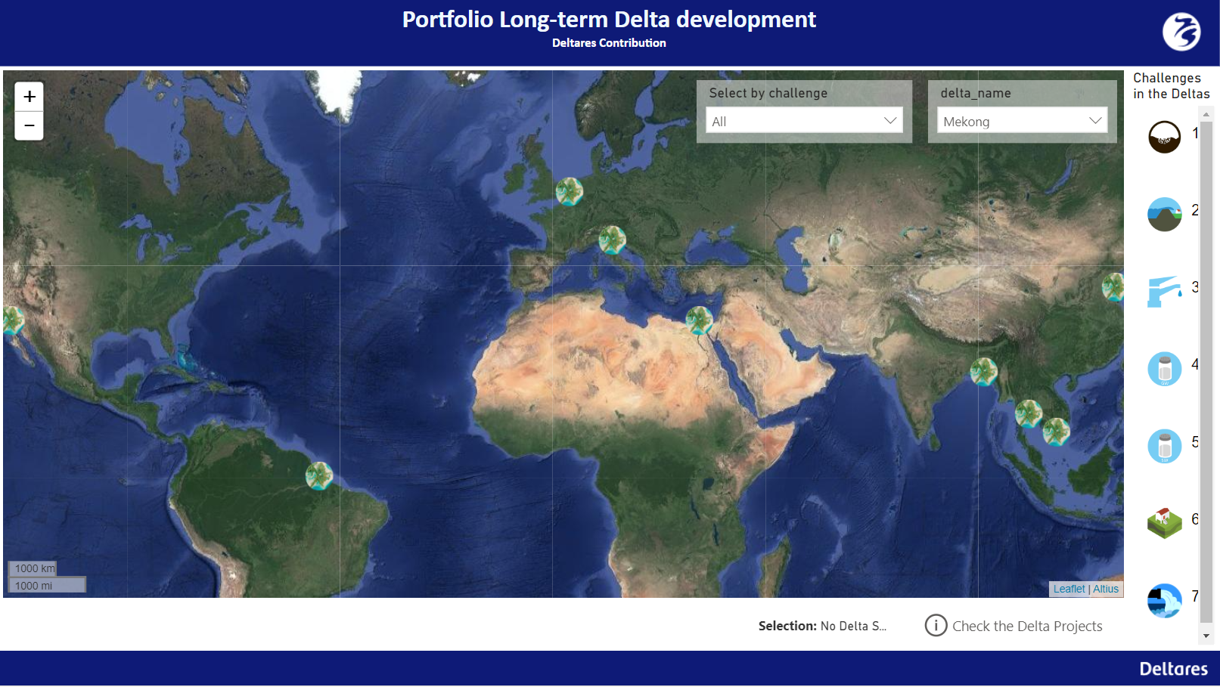
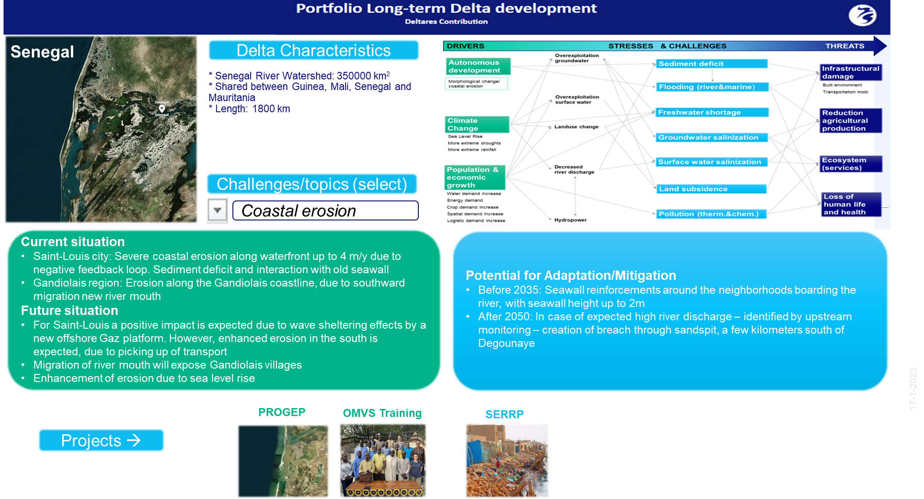
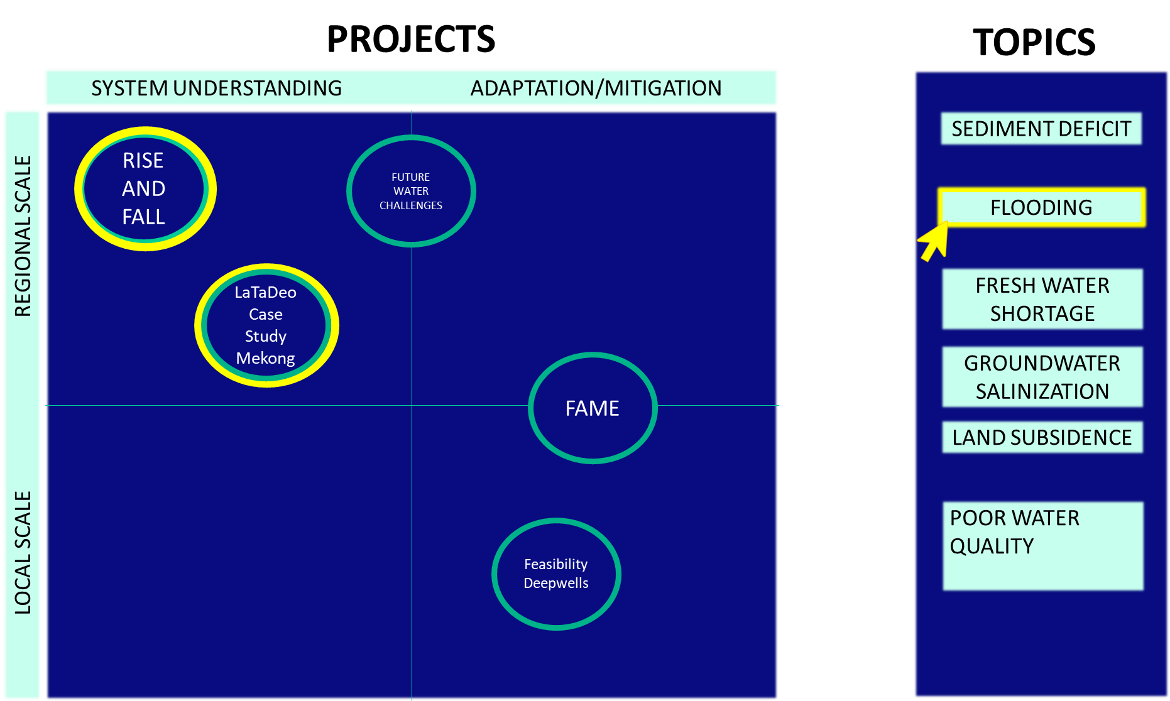
Framework
Startscherm
Description Delta’s
More

Slide 6
Startscherm
Per delta niet uitdagingen, maar # uitgevoerde studies
Doorklikken op delta geeft volgende slide

Slide 7
Set-up Delta description

Slide 8
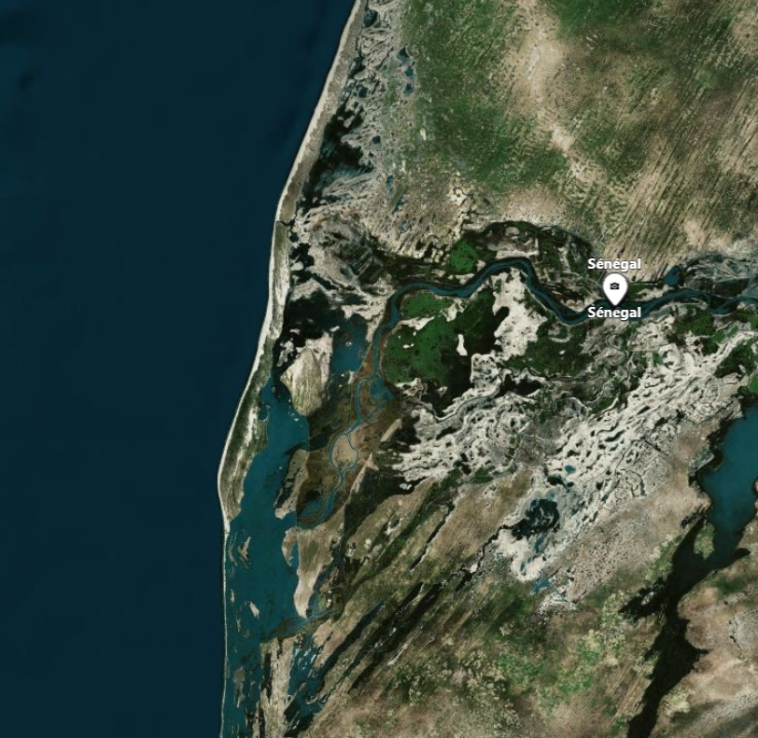
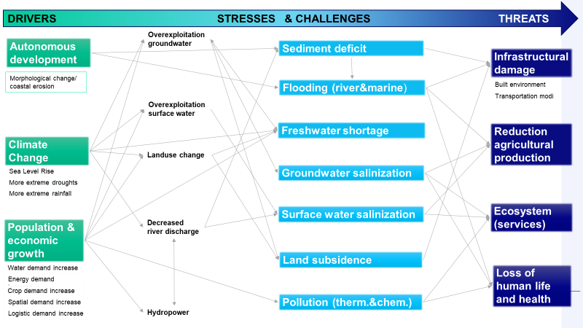
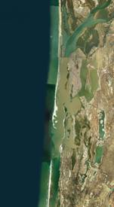
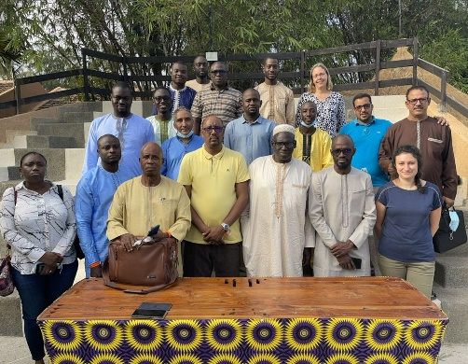
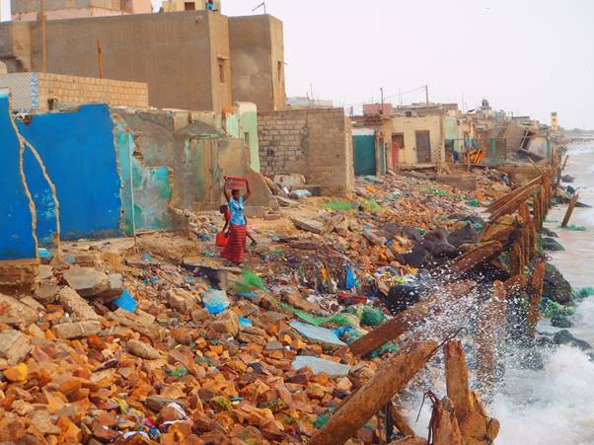
* Senegal River Watershed: 350000 km² * Shared between Guinea, Mali, Senegal and Mauritania * Length: 1800 km
Senegal
Delta Characteristics
Challenges/topics (select)
Coastal erosion
Current situation
Saint-Louis city: Severe coastal erosion along waterfront up to 4 m/y due to negative feedback loop. Sediment deficit and interaction with old seawall
Gandiolais region: Erosion along the Gandiolais coastline, due to southward migration new river mouth
Future situation
For Saint-Louis a positive impact is expected due to wave sheltering effects by a new offshore Gaz platform. However, enhanced erosion in the south is expected, due to picking up of transport
Migration of river mouth will expose Gandiolais villages
Enhancement of erosion due to sea level rise
Potential for Adaptation/Mitigation
Before 2035: Seawall reinforcements around the neighborhoods boarding the river, with seawall height up to 2m
After 2050: In case of expected high river discharge – identified by upstream monitoring – creation of breach through sandspit, a few kilometers south of Degounaye
PROGEP
OMVS Training
SERRP
Projects →

Slide 9

* Senegal River Watershed: 350000 km² * Shared between Guinea, Mali, Senegal and Mauritania * Length: 1800 km
Senegal
Delta Characteristics
Challenges/topics (select)
Coastal erosion
River flooding
Marine flooding
Salinization
Navigability
Env. degradation
Current situation
Saint-Louis city: Severe coastal erosion along waterfront up to 4 m/y due to negative feedback loop. Sediment deficit and interaction with old seawall
Gandiolais region: Erosion along the Gandiolais coastline, due to southward migration new river mouth
Future situation
For Saint-Louis a positive impact is expected due to wave sheltering effects by a new offshore Gaz platform. However, enhanced erosion in the south is expected, due to picking up of transport
Migration of river mouth will expose Gandiolais villages
Enhancement of erosion due to sea level rise
Potential for Adaptation/Mitigation
Saint-Louis city: Large beach nourishment ~2.5 Mm3 + around 2050: Dike heightening/groin if needed.
Gandiolais region : Periodic localized sand nourishments in front of villages
PROGEP
OMVS Training
SERRP
Projects →

Slide 10
* Senegal River Watershed: 350000 km² * Shared between Guinea, Mali, Senegal and Mauritania * Length: 1800 km
Senegal
Delta Characteristics
Challenges/topics (select)
River flooding
Current situation
High flood risk in the city of Saint-Louis, due to its location in and along the river, its low-lying neighborhoods, poor state of seawalls and drainage system
Future situation
Increasing flood risk due to southward migration of the river mouth.
Up to 2050 larger river discharges are expected
After 2050 a potential decline in river discharge
Potential for Adaptation/Mitigation
Before 2035: Seawall reinforcements around the neighborhoods boarding the river, with seawall height up to 2m
After 2050: In case of expected high river discharge – identified by upstream monitoring – creation of breach through sandspit, a few kilometers south of Degounaye
PROGEP
OMVS Training
SERRP
Projects →

Slide 11
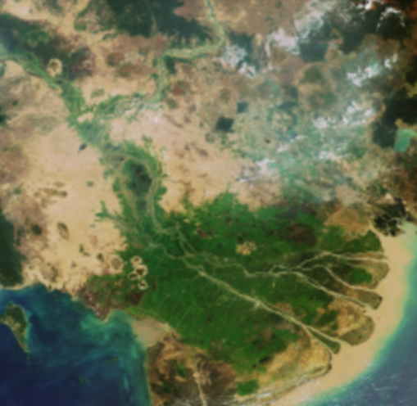
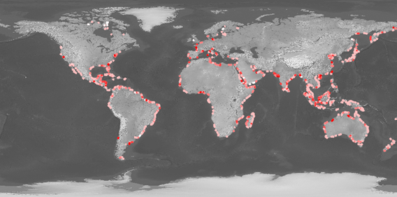
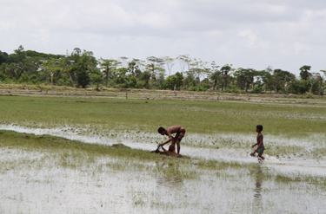
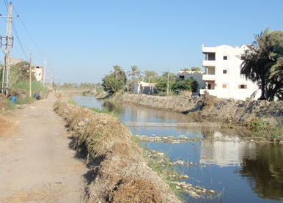
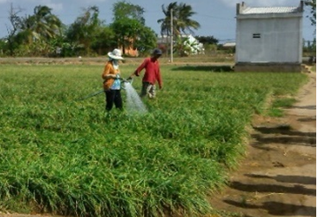
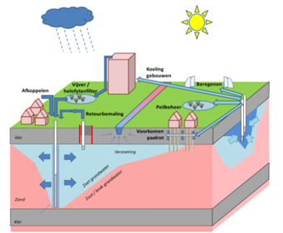
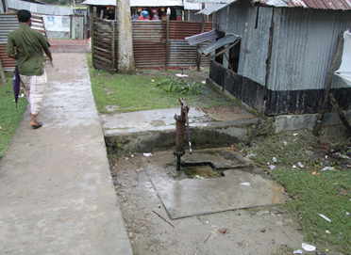
* Number of inhabitants: 12 Million * GDP: 120 Billion, ow which agriculture 40% * 40% of Vietnam’s cereal production (mainly rice) * 75% of Vietnam’s aquaculture production * 38% of Vietnam’s marine fishery * 40% of Vietnam’
Mekong
Delta Characteristics
Challenges/topics (select)
Subsidence
Current situation
Severely threatened by soil subsidence
Anthropogenic influences explain 65-92% of subsidence
Current best estimate of subsidence rate is 9 mm/yr
Some areas subside by over 25 mm/yr
Future situation
Large part of Mekong Delta will very likely be below sea level in the next 100 years
Potential for Adaptation/Mitigation
Reduce groundwater use
Stimulate groundwater recharge
Re-enable sedimentation on the delta plain
Value delta elevation as depletable natural resource
Case Study Future Water Challenges
Case Study
LaTeDeo
Database Webtool
Rise and Fall
Fame
Pre-feasibility Study Deepwell ASR
Projects →

Slide 12
DRIVERS STRESSES & CHALLENGES THREATS
Overexploitation groundwater
Autonomous development
Sediment deficit
Infrastructural damage
Morphological change/ coastal erosion
Built environment
Flooding (river&marine)
Transportation modi
Overexploitation surface water
Freshwater shortage
Reduction agricultural production
Climate Change
Landuse change
Sea Level Rise
Groundwater salinization
More extreme droughts
More extreme rainfall
Surface water salinization
Ecosystem (services) loss
Population & economic growth
Decreased river discharge
Land subsidence
Water demand increase
Loss of human life and health
Energy demand increase
Crop demand increase
Spatial demand increase
Pollution (therm.&chem.)
Logistic demand increase
Hydropower

Slide 13
DRIVERS STRESSES & CHALLENGES THREATS
Overexploitation groundwater
Autonomous development
Sediment deficit
Infrastructural damage
Morphological change/ coastal erosion
Built environment
Flooding (river&marine)
Transportation modi
Overexploitation surface water
Freshwater shortage
Reduction agricultural production
Climate Change
Landuse change
Sea Level Rise
Groundwater salinization
More extreme droughts
More extreme rainfall
Surface water salinization
Ecosystem (services) loss
Population & economic growth
Decreased river discharge
Land subsidence
Water demand increase
Loss of human life and health
Energy demand increase
Crop demand increase
Spatial demand increase
Pollution (therm.&chem.)
Logistic demand increase
Hydropower

Slide 14
Framework
Startscherm
Description Delta’s
More

Slide 15
PROJECTS
TOPICS
SYSTEM UNDERSTANDING ADAPTATION/MITIGATION
SEDIMENT DEFICIT
SEDIMENT DEFICIT
RISE AND FALL
FUTURE WATER CHALLENGES
FLOODING
FLOODING
FRESH WATER SHORTAGE
LaTaDeo Case Study Mekong
FRESH WATER SHORTAGE
GROUNDWATER SALINIZATION
FAME
GROUNDWATER SALINIZATION
LOCAL SCALE REGIONAL SCALE
LAND SUBSIDENCE
LAND SUBSIDENCE
POOR WATER QUALITY
POOR WATER QUALITY
Feasibility Deepwells

Slide 16
PROJECTS
TOPICS
SYSTEM UNDERSTANDING ADAPTATION/MITIGATION
SEDIMENT DEFICIT
SEDIMENT DEFICIT
RISE AND FALL
FUTURE WATER CHALLENGES
FLOODING
FLOODING
FRESH WATER SHORTAGE
LaTaDeo Case Study Mekong
FRESH WATER SHORTAGE
GROUNDWATER SALINIZATION
FAME
GROUNDWATER SALINIZATION
LOCAL SCALE REGIONAL SCALE
LAND SUBSIDENCE
LAND SUBSIDENCE
POOR WATER QUALITY
POOR WATER QUALITY
Feasibility Deepwells

Slide 17
PROJECTS
TOPICS
SYSTEM UNDERSTANDING ADAPTATION/MITIGATION
SEDIMENT DEFICIT
SEDIMENT DEFICIT
RISE AND FALL
FUTURE WATER CHALLENGES
FLOODING
FLOODING
FRESH WATER SHORTAGE
LaTaDeo Case Study Mekong
FRESH WATER SHORTAGE
GROUNDWATER SALINIZATION
FAME
GROUNDWATER SALINIZATION
LOCAL SCALE REGIONAL SCALE
LAND SUBSIDENCE
LAND SUBSIDENCE
POOR WATER QUALITY
POOR WATER QUALITY
Feasibility Deepwells

Slide 18
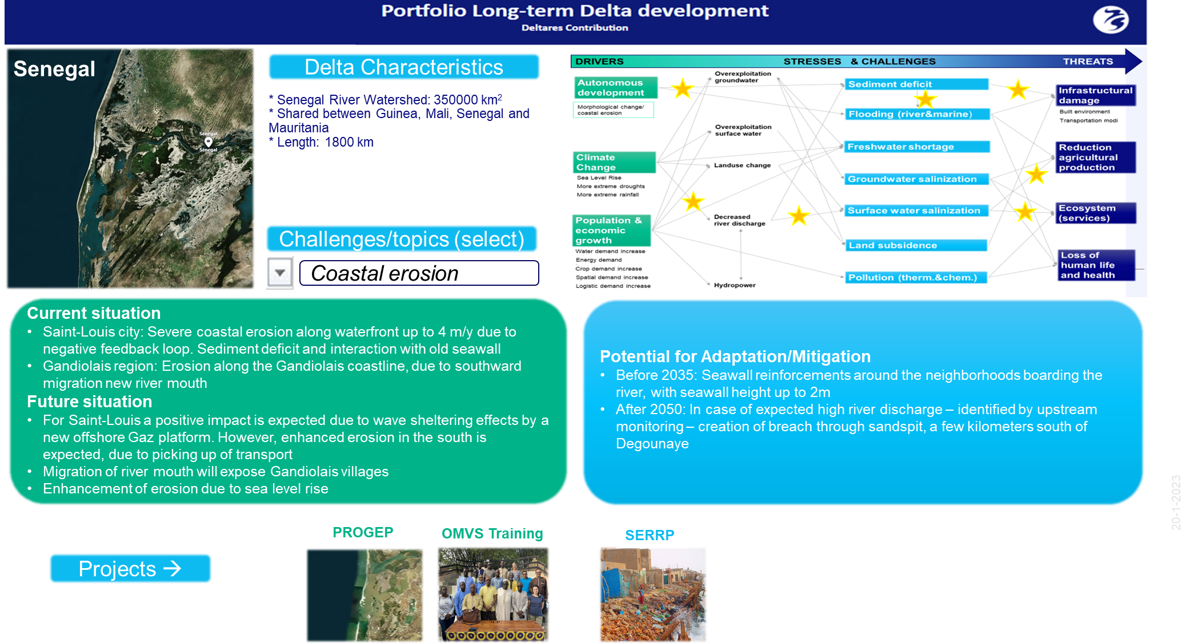
Concluding
Set-up project description
Set up reflects our generic Deltares approach:
It starts always with system understanding
Then we goto Adaptation and mitigation
Set-up quickly gives an overview of the main aspects we studied and the interference between aspects (yellow stars)
Set-up “verdieping”
Shows our diversity in projects and focus
Visualises relations between projects / integrality
Reflects the width of expertise within Deltares

Slide 19
And ….
We should test the concept with more projects and thus more people
We still have questions like: Should we do more with impact or functions?
The portfolio gives us:
Integral overview Deltares activities
and an idea of opportunities, missing links
Better understanding between collegues from different units: Groundwater meets Surface water
It is all about the Art of Leaving Out
We did learn something ourselves:
We all want something different. Yes, we are Deltarians

Slide 20
Contact
www.deltares.nl
@deltares
linkedin.com/company/deltares
info@deltares.nl
@deltares
facebook.com/deltaresNL
facebook.com/deltaresNL
linkedin.com/company/deltares
@deltares
@deltaresNL

